Slide 1

Insurance Dashboard Insights
This presentation will dive into the key performance indicators and insights from the insurance company's data dashboards. We'll explore the team's achievements, opportunities for growth, and the data-driven decisions that will drive success.

Slide 2
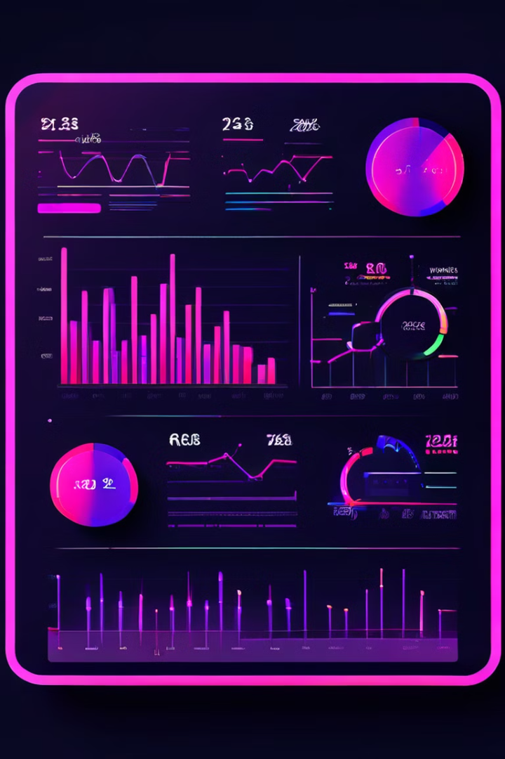
Key Performance Indicators
1
Cross Sell
Measures performance in cross-selling insurance products.
2
New Policies
Tracks the performance of new insurance policies.
3
Renewals
Monitors the renewal rate and performance of existing policies.
4
Invoice & Meetings
Evaluates the productivity of account executives.

Slide 3
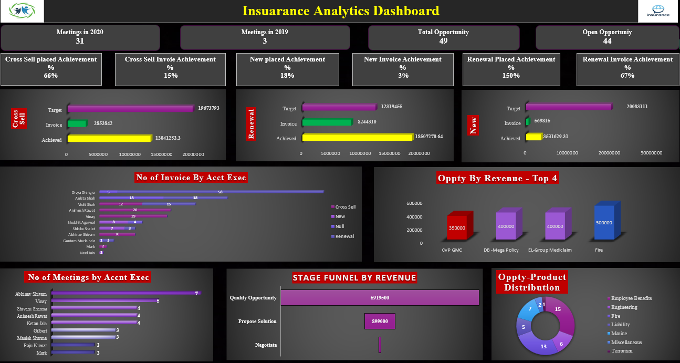
Excel Dashboard
The Excel-based dashboard provides a comprehensive view of the insurance company's performance across various metrics, enabling data-driven decision making.

Slide 4
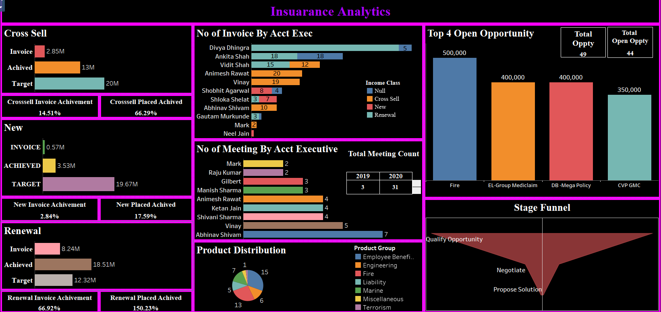
The Tableau dashboard offers advanced data visualization and interactive capabilities, allowing the team to explore insights and trends in the insurance data.
Tableau Dashboard

Slide 5
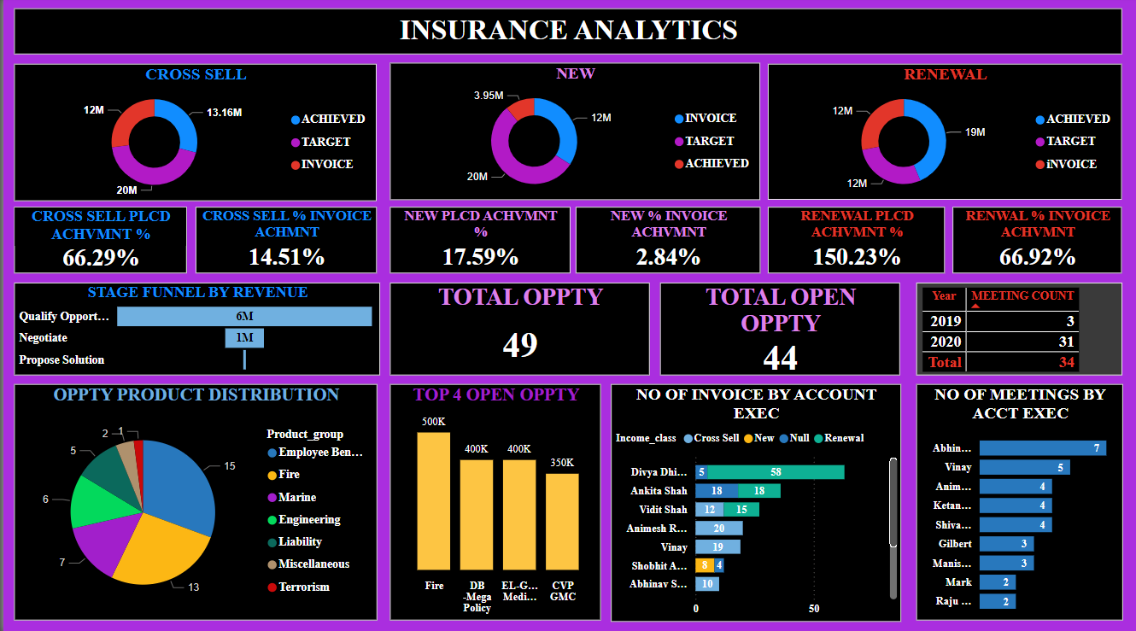
Power BI Dashboard
The Power BI dashboard integrates multiple data sources and provides a centralized view of the insurance company's performance, enabling efficient monitoring and reporting.

Slide 6


Key Insights
1
Renewal Opportunities
The Cross Sell achievement rate is highest in the Renewal category, indicating a strong focus on retaining existing customers.
2
Productivity Trends
Account executives with higher meeting counts generally show better performance in invoicing, suggesting the importance of client engagement.
3
Closing the Deal
The stage funnel shows a significant drop-off from Qualification to Proposal, indicating room for improvement in closing deals.
4
Product Mix
Product distribution is dominated by Employee Benefits and Fire categories, highlighting the need to diversify the insurance portfolio.

Slide 7

Thank You
We appreciate your time and look forward to discussing how these insights can drive continued growth and success for the insurance business.

